Slide 1
Chapter 2
How LAN and WANCommunications Work

Slide 2
Object
• Explain the OSI reference model, which sets standards for LAN and WAN
communications
• Discuss communication between OSI stacks when two computers are linked through a network
• Apply the OSI model to realistic networking situations
• Describe major LAN transmission methods
• Explain the basic WAN network communications topologies and
transmission methods, including telecommunications, cable TV, satellite, and wireless technologies
• Explain the advantages of using Ethernet in network designs
http://fpt.edu.vn

Slide 3
The OSI Reference Model
Networks rely upon standards
Open Systems Interconnection (OSI) reference model
  Fundamental network communications model
OSI model product of two standards organizations
  International Organization for Standardization (ISO)
  American National Standards Institute (ANSI)
OSI is theoretical, not specific hardware or software
OSI guidelines analogized to a grammar
http://fpt.edu.vn

Slide 4
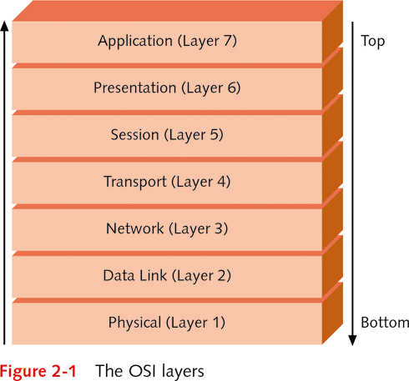
The OSI Reference Model (continued)
Accomplishments of the OSI model
  Enabling communications among LANs, MANs, WANs
  Standardizing network equipment
  Enabling backward compatibility to protect investments
  Enabling development of software and hardware with common interfaces
  Making worldwide networks possible; e.g., the Internet
OSI model consists of seven distinct layers
  Physical, Data Link, Network, Transport, Session, Presentation, and Application
http://fpt.edu.vn

Slide 5
The OSI Reference Model (continued)
Set of layers in OSI model is called a stack
Layers called by actual name or placement in stack
Layers also divided into three groups
  Bottom: handles physical communications
  Middle: coordinates communication between nodes
  Top: involves data presentation
Contact between two network devices
  Communications traverse layered stack in each device
  Each layer handles specific tasks
  Each layer communicates with next layer using protocol
http://fpt.edu.vn

Slide 6
Physical Layer
Layer purpose: transmit and receive signals with data
Responsibilities of the Physical layer (Layer 1)
  All data transfer mediums
    wire cable, fiber optics, radio waves, and microwaves
  Network connectors
  The network topology
  Signaling and encoding methods
  Data transmission devices
  Network interfaces
  Detection of signaling errors
http://fpt.edu.vn

Slide 7
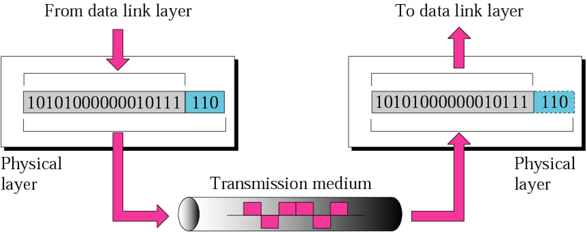
Physical Layer (continued)
Network signals are either analog or digital
Analog signal
  Wave pattern with positive and negative voltages
  Examples: ordinary telephone or radio signal
  Used in WANs that employ analog modems
Digital signal generates binary 1s or 0s
  Most common signaling method on LANs and high-speed WANs
  Example 1: +5 volts produces 1, 0 volts produce 0
  Example 2: +5 volts produces 1, -5 volts produce 0
  Example 3 (Fiber-optics): presence of light is 1, else 0
http://fpt.edu.vn

Slide 8
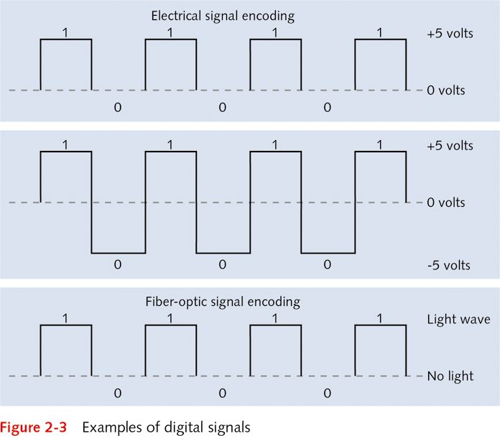
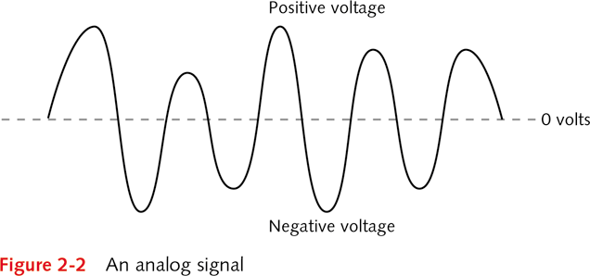
http://fpt.edu.vn

Slide 9
Physical Layer (continued)
Physical network problems affect physical layer
  Example 1: broken cable
  Example 2: electrical or magnetic interference
Electromagnetic interference (EMI)
  Caused by magnetic force fields
  Generated by certain electrical devices
    Fans, electric motors, portable heaters, air-conditioners
Radio frequency interference (RFI)
  Caused by electrical devices emitting radio waves
    Radio and television stations, radio operators, cable TV
  Problem when frequency matches network signal
http://fpt.edu.vn

Slide 10
Data Link Layer
Layer purpose: format bits into frames
Frame: discrete unit of information
  Contains control and address information
  Does not contain routing information
Steps required to activate data link
  Two nodes establish physical connection
  Data Link layers connected logically through protocols
  Data Link layer decodes signal into individual frames
Cyclic redundancy check (CRC): monitor duplication
  Calculates size of information fields in frame
  Data Link layer at sender inserts value at end of frame
  Receiving Data Link layer checks value in frame
http://fpt.edu.vn

Slide 11
Data Link Layer (continued)
Logical link control sublayer (LLC)
  Initiates communication link between two nodes
  Guards against interruptions to link
  Link to Network layer may be connection-oriented
Media access control sublayer (MAC)
  Examines physical (device or MAC) address in frame
  Frame discarded if address does not match workstation
  Regulates communication sharing
MAC address burned into chip on network interface
  Coded as a hexadecimal number; e.g., 0004AC8428DE
    First half refers to vendor, second half unique to device
http://fpt.edu.vn

Slide 12
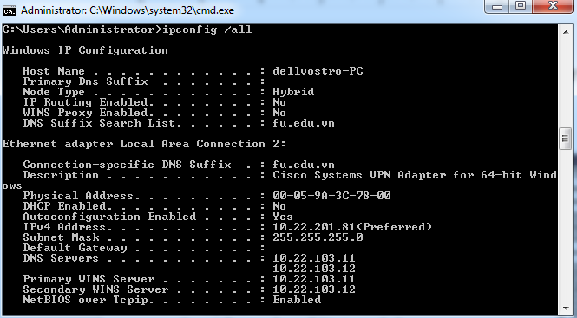
Network Layer
Layer purpose: control passage of packets on network
  Physical routes: cable and wireless paths
  Logical routes: software paths
Packet: discrete unit of information (like a frame)
  Formatted for transmission as signal over network
  Composed of data bits in fields of information
  Corresponds to network information sent at Network layer of OSI model
Specific tasks of Network layer
  Optimize physical and logical routes
  Permit routers to move packets between networks
http://fpt.edu.vn

Slide 13
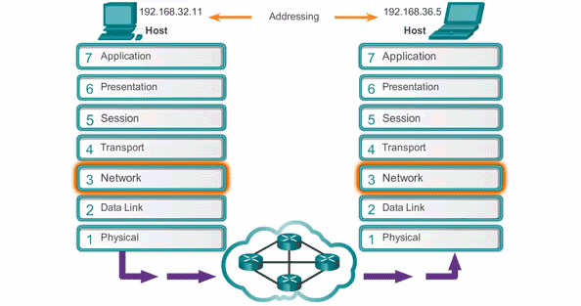
Network Layer (continued)
Discovery: process of information gathering
  Obtain metrics about location of networks and nodes
Virtual circuits: logical communication paths
  Send and receive data
  Known only to Network layers between nodes
  Benefit: manage parallel data paths
Extra duties using virtual circuits
  Checks (and corrects) packet sequence
  Addresses packets
  Resizes packets to match receiving network protocol
  Synchronizes flow of data between Network layers
http://fpt.edu.vn

Slide 14
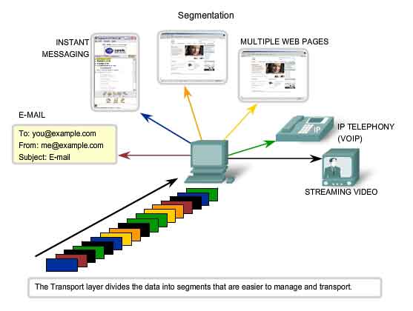
Transport Layer
Layer purpose: reliable data transmission
  Ensures data sent and received in same order
  Receiving node sends acknowledgement ("ack")
Transport layer support of virtual circuits
  Tracks unique identification value assigned to circuit
    Value called a port or socket
    Port assigned by Session layer
  Establishes level of packet checking
Five reliability measures used by protocols
Transport layer mediates between different protocols
http://fpt.edu.vn

Slide 15
Session Layer
Multiple goals
  Establish and maintain link between two nodes
  Provide for orderly transmission between nodes
  Determine how long node can transmit
  Determine how to recover from transmission errors
  Link unique address to each node (like a zip code)
Half duplex communications
  Two-way alternate mode (TWA) for dialog control
    Sets up node to separately send and receive
    Analogize to use of walkie-talkies
http://fpt.edu.vn

Slide 16
Session Layer (continued)
Full duplex communications
  Two-way simultaneous (TWS) for dialog control
    Devices configured to send and receive at same time
  Increases efficiency two-fold
  Made possible by buffering at network interface
Simplex alternative
  Signal can travel in only one direction in a medium
  Not as desirable as either half or full duplex
http://fpt.edu.vn

Slide 17
Presentation Layer
Primary purpose: manages data formatting
  Acts like a syntax checker
  Ensures data is readable to receiving Presentation layer
Translates between distinct character codes
  EBCDIC (Extended Binary Coded Decimal Interchange Code)
    8-bit coding method for 256-character set
    Used mainly by IBM computers
  ASCII (American Standard Code for Information Interchange)
    8-bit character coding method for 128 characters
    Used by workstations running Windows XP, Fedora, Linux
http://fpt.edu.vn

Slide 18
Presentation Layer (continued)
Two additional responsibilities
  Encryption: scrambling data to foil unauthorized users
    Example 1: account password encrypted on LAN
    Example 2: credit card encrypted on a LAN
    Encryption tool: Secure Sockets Layer (SSL)
  Data compression: compact data to conserve space
    Presentation layer at receiving node decompresses data
http://fpt.edu.vn

Slide 19
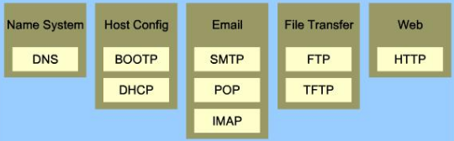
Application Layer
Services managed by Application layer
  File transfer, file management, remote access to files
  Remote access to printers
  Message handling for electronic mail
  Terminal emulation
Connecting workstations to network services
  Link application into electronic mail
  Providing database access over the network
Microsoft Windows redirector
  Makes computer visible to another for network access
  Example: access shared folder using redirector
http://fpt.edu.vn

Slide 20
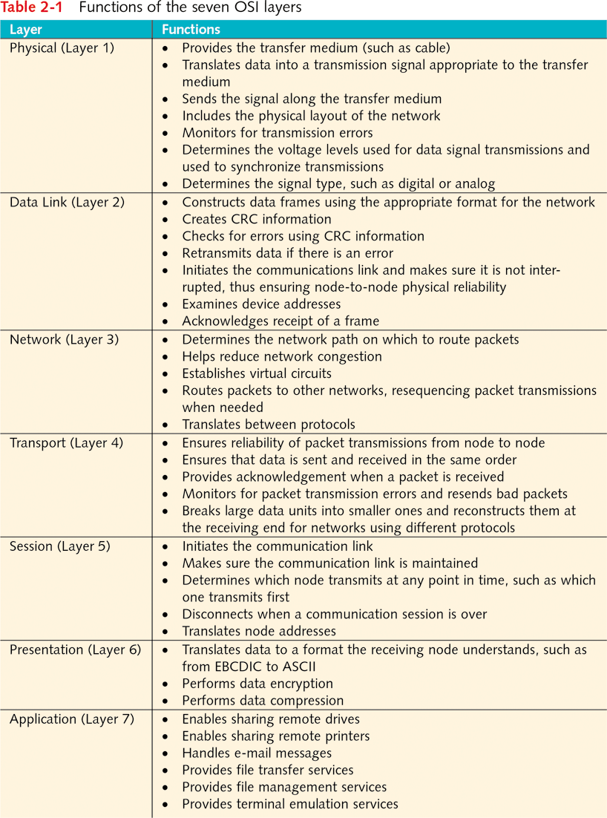
http://fpt.edu.vn

Slide 21
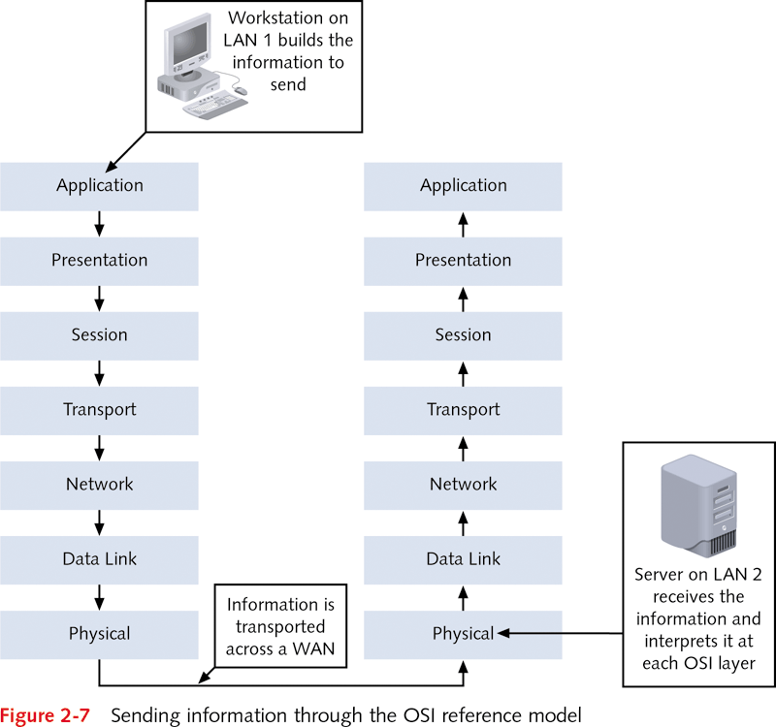
Communicating Between Stacks
OSI model enables two computers to communicate
Standards provided by OSI models
  Communicating on a LAN
  Communicating between LANs
  Internetworking between WANs and LANs (and WANs)
Constructing a message at the sending node
  Message created at Application layer
  Message travels down stack to Physical layer
  Information at each layer added to message
    Layer information is encapsulated
  Message sent out to network form Physical layer
http://fpt.edu.vn

Slide 22
Communicating Between Stacks (continued)
Interpreting the message at the receiving node
  Message travels up stack from Physical layer
  Data Link layer checks address of frame
  Data Link layer uses CRC to check frame integrity
  Network layer receives valid frame and sends up stack
Each layer in the stack acts as a separate module
Peer protocols: enable sending layer to link with receiving layer
Information transferred using primitive commands
  Protocol data unit (PDU): term for transferred data
http://fpt.edu.vn

Slide 23
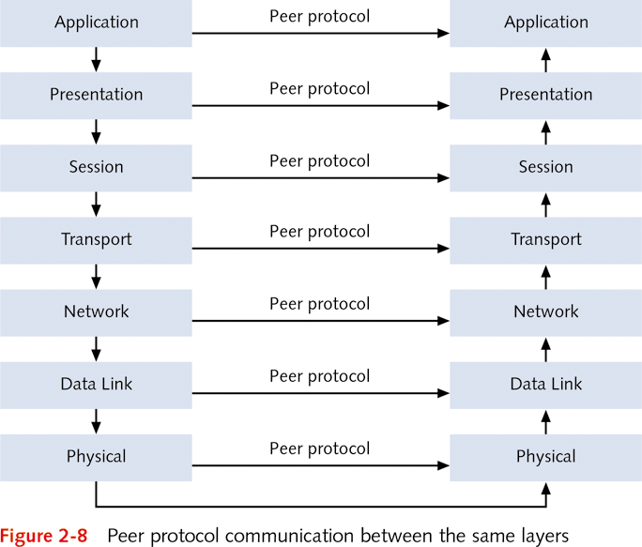
http://fpt.edu.vn

Slide 24
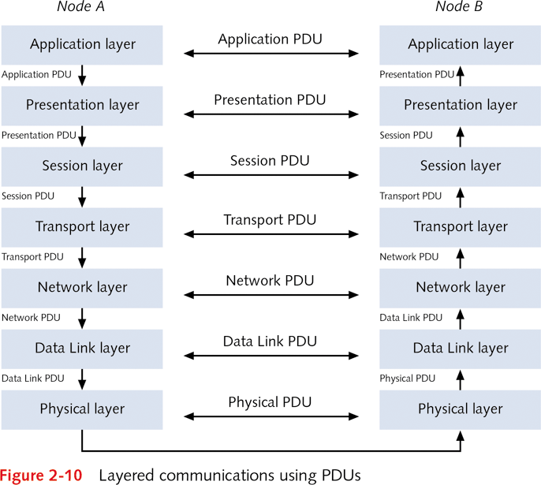
Communicating Between Stacks (continued)
Control data added to PDU as it traverses stack
  Next layer gets transfer instructions from previous layer
    Next layer strips transfer/control information
    Service data unit (SDU) remains after data stripped
  Peer protocols used to communicate with companion layer
Key points
  Each layer forms a PDU (from an SDU)
  Each PDU is communicated to counterpart PDU
http://fpt.edu.vn

Slide 25
Applying the OSI Model
Example: workstation accesses shared drive
  Redirector at Application layer locates shared drive
  Presentation layer ensures data format is ASCII
  Session layer establishes and maintains link
  Transport layer monitors transmission/reception errors
  Network layer routes packet along shortest path
  Data Link layer formats frames, verifies address
  Physical layer converts data to electrical signal
OSI model also applied to network hardware and software communications
http://fpt.edu.vn

Slide 26
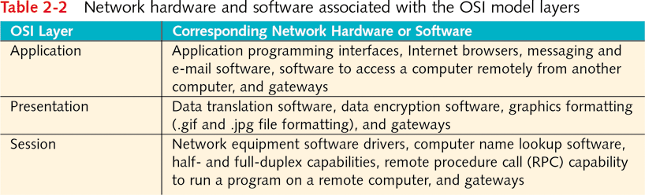
http://fpt.edu.vn

Slide 27
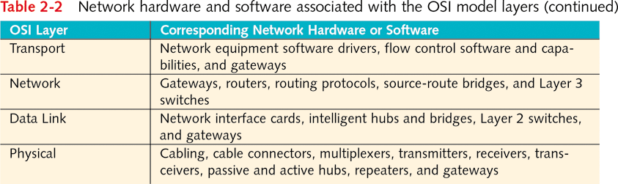
http://fpt.edu.vn

Slide 28
Understanding the Role of Requests for Comments
Request for Comment (RFC): basis for standards and conventions
RFCs managed by IETF (Internet Engineering Task Force)
  RFCs evaluated by IESG (Internet Engineering Steering Group) within IETF
RFCs assigned unique identification number
Two kinds of RFC documents
  Universal Protocol for transferring data on Internet
  Informational RFCs (RFC 2555 provides RFC history)
http://fpt.edu.vn

Slide 29
LAN Transmission Methods
Two main LAN transmission methods
  Ethernet: defined in IEEE 802.3 specifications
  Token ring: defined in IEEE 802.5 specifications
Ethernet is more widespread than token ring
  Has more high-speed and expansion options
Fiber Distributed Data Interface (FDDI): high-speed variation of token ring
http://fpt.edu.vn

Slide 30
Ethernet
Leverages bus and star topologies
Control method: Carrier Sense Multiple Access with Collision Detection (CSMA/CD)
  Algorithm that transmits and decodes formatted frames
Permits only one node to transmit at a time
  All nodes wishing to transmit frame are in contention
  No single node has priority over another node
  Nodes listen for packet traffic on cable
  If packet detected, nonsending nodes go in "defer" mode
    Carrier sense: process of detecting signal presence
Collision occurs if two nodes transmit simultaneously
  Sending node recovers with collision detection software
http://fpt.edu.vn

Slide 31
Ethernet (continued)
Frames find destination through physical addressing
  Node has unique MAC address associated with NIC
Functions performed with network drivers
  Network access, data encapsulation, addressing
Data transmitted in Ethernet encapsulated in frames
Frame composed of six predefined fields
  Preamble
  Start of frame delimiter (SFD or SOF):
  Destination address (DA) and source address (SA):
  Length (Len)
  Data and pad
  Frame check sequence or frame checksum (FCS)
http://fpt.edu.vn

Slide 32
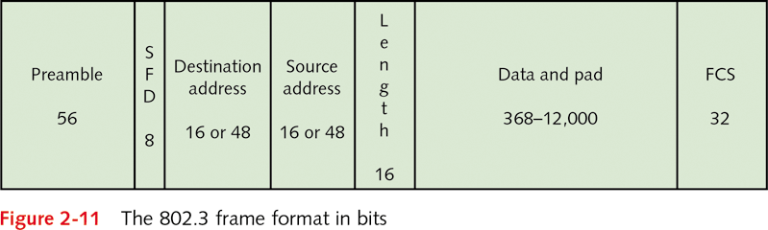
http://fpt.edu.vn

Slide 33
Token Ring
Token ring transport method
  Uses physical star topology and logic of ring topology
  Data transmission up to 100 Mbps
Multistation access unit (MAU): hub ensures packet circulated
Token: specialized packet continuously transmitted
  Size: 24 bits
  Structure: three 8-bit fields
    Starting delimiter (SD)
    Access control (AC)
    Ending delimiter (ED)
Frame associated with token has thirteen fields
http://fpt.edu.vn

Slide 34
Token Ring (continued)
Using a token
  Node must capture token to transmit
  Node builds frame using token fields
  Resulting frame sent around ring to target node
  Target node acknowledges frame received and read
  Target node sends frame back to transmitting node
  Transmitting node reuses token or returns it to ring
Active monitor uses broadcast frame to check nodes
Beaconing: node sends frame to indicate problem
  Ring tries to self-correct problem
Token ring networks reliable
  Broadcast storms and interference are rare
http://fpt.edu.vn

Slide 35
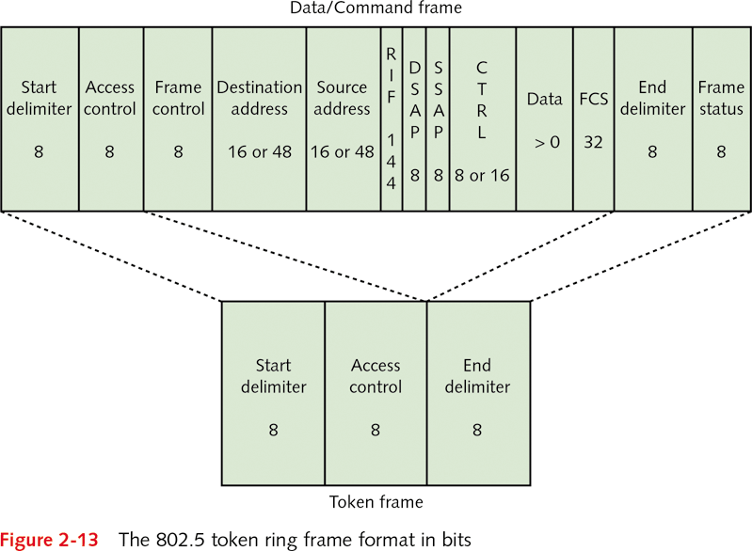
http://fpt.edu.vn

Slide 36
FDDI
Fiber Distributed Data Interface (FDDI)
  Standard for high-capacity data throughput 100 Mbps
FDDI uses fiber-optic cable communications medium
FDDI uses timed token access method
  Send frames during target token rotation time (TTRT)
  Allows for parallel frame transmission
Two types of packets
  Synchronous communications (time-sensitive traffic)
  Asynchronous communications (normal traffic)
Two classes of nodes connect to FDDI network
  Class A: nodes attached to both rings (hubs)
  Class B: node (workstation) attached via Class A node
http://fpt.edu.vn

Slide 37
WAN Network Communications
WANs built on topologies and network transmission
  Similar to LAN structure, with greater complexity
  Providers do not provide detailed specifications
WAN network service providers
  Telecommunications companies
    Especially regional telephone companies (telcos or RBOCs (regional bell operating companies))
  Cable television companies (cablecos)
  Satellite TV companies
http://fpt.edu.vn

Slide 38
Telecommunications WANs
Plain old telephone service (POTS)
  Carry most basic WAN communications
  56-Kbps dial-up access, Integrated Service Digital Network (ISDN), Digital Subscriber Line (DSL)
Topology between RBOCs and long distance carrier
  RBOC provides local access and transport area (LATA)
  IXC lines join RBOC and long distance carrier
    Point of presence (POP) is term for junction
T-carrier lines: dedicated telephone line for data link
  Example: states use to connect offices to capitol
Alternative to T-carrier: synchronous 56-Kbps service
http://fpt.edu.vn

Slide 39
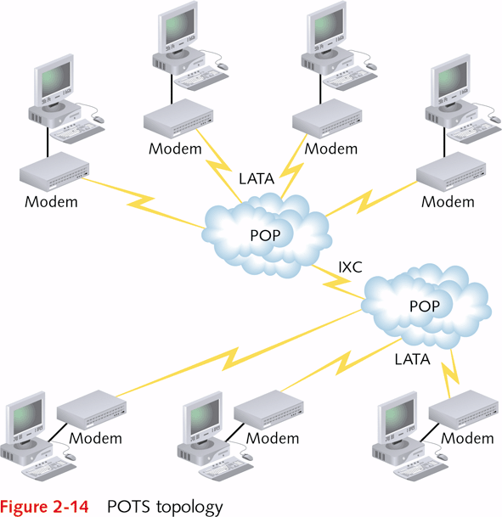
http://fpt.edu.vn

Slide 40
Cable TV WANs
Architecture consists of star-shaped locations
Headend is the focal point in the star
  Central receiving point for various signals
    Grouping of antennas, cable connections, satellite dishes, microwave towers
  Signals distilled, transferred to distribution centers
Distribution centers transfer signals to feeder cables
  Homes use drop cables to tap into feeder cables
Cable modems convert signals for computer use
  Upstream frequency differs from downstream
  Example: 30 Mbps upstream and 15 Mbps downstream
http://fpt.edu.vn

Slide 41
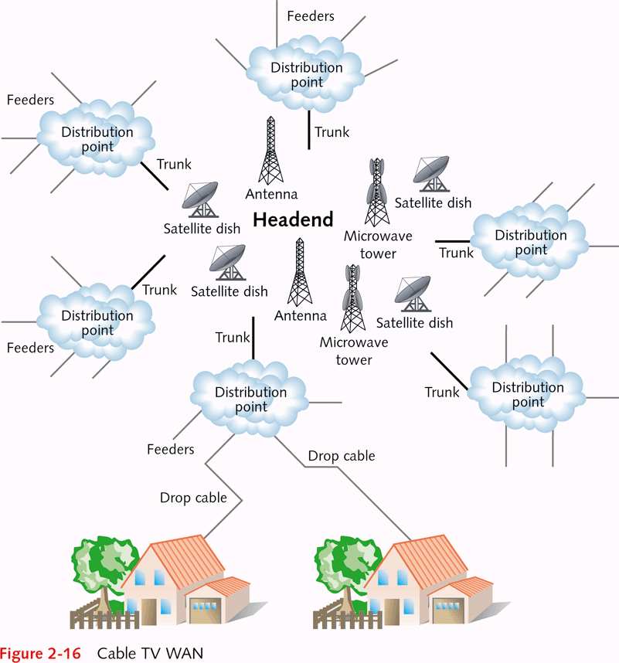
http://fpt.edu.vn

Slide 42
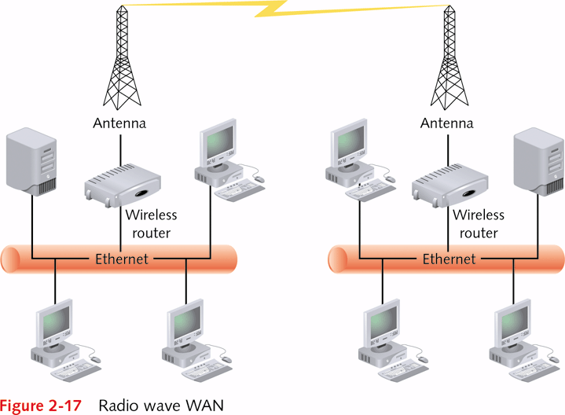
Wireless WANs
Wireless WANS: use of radio, microwaves, satellites
Topology of radio communications
  Connect wireless LAN to wireless bridge or switch
  Connect bridge or switch to antenna
  Antenna transmits wave to distant antenna
Topology of microwave communication
  Connect microwave dish to LAN
  Dish transmits to microwave dish at remote location
Topology of satellite communications
  Satellite dish transmits to satellite in space
  Satellite relays signal to satellite dish at remote location
http://fpt.edu.vn

Slide 43
WAN Transmission Methods
Switching techniques creating data paths (channels)
  Time Division Multiple Access (TDMA): divides the channels into distinct time slots
  Frequency Division Multiple Access (FDMA): divides the channels into frequencies instead of time slots
  Statistical multiple access: bandwidth of cable dynamically allocated based on application need
  Circuit switching: involves creating a dedicated physical circuit between the sending and receiving nodes
  Message switching: uses store-and-forward method to transmit data from sending to receiving node
  Packet switching: establishes a dedicated logical circuit between the two transmitting nodes
http://fpt.edu.vn

Slide 44
Designing an Ethernet Network
Scenario: new campus needs new network
Reasons for choosing Ethernet technology
  Ethernet enjoys widespread vendor/technical support
  Compatible with star-bus topology popular with LANs
  Network upgrades easily to higher bandwidths
  Standards exist for cable and wireless versions
  Ethernet network scales well, adapts well to WANs
  Network devices on old campus may be used
  Many options for Internet connections
Ethernet appropriate for all areas of new campus
http://fpt.edu.vn

Slide 45
Q & A
http://fpt.edu.vn

